Slide 1
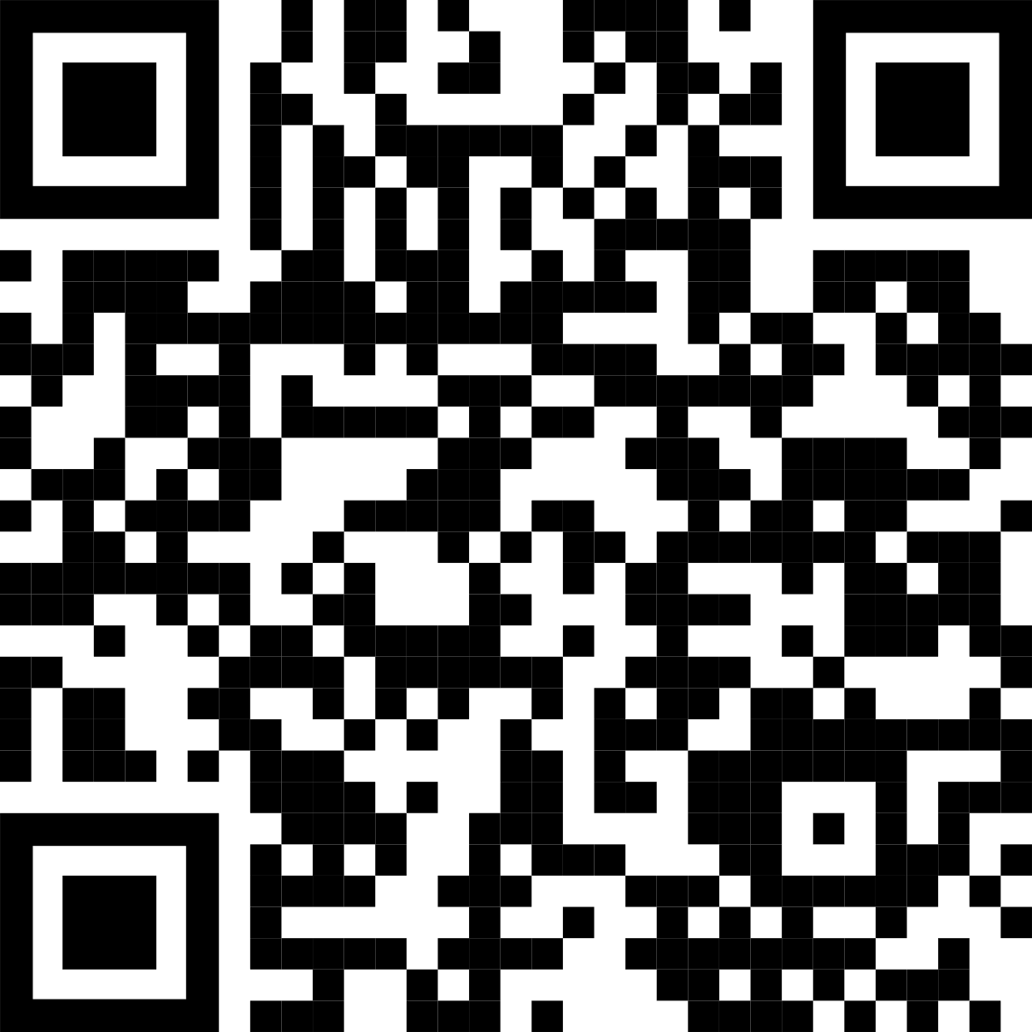
Conclusions: Over the six-year period mortality rates for HIV/TB patients were consistently higher than for PLHIV who have no TB. More efforts should be directed into improving nutritional status among HIV patients, as it has destructive interaction with TB for mortality. This will improve patients’ body weight and CD4 counts which are protective against mortality. Among PLHIV attention should be given to those who are in WHO HIV stage 3 or 4 and having TB co-infection.
Non-Cognitive Predictors of Student Success: A Predictive Validity Comparison Between Domestic and International Students
Non-Cognitive Predictors of Student Success: A Predictive Validity Comparison Between Domestic and International Students
Effect of Tuberculosis infection on Mortality of HIV infected Patients in northern Tanzania
used to analyze the data to determine
mortality rate ratios (RR) and 95% confidence intervals (95%CI).
Results: Among all PLHIV the overall mortality rate was 28.4 (95% CI 27.6-29.2) deaths per 1000 person-years. For PLHIV with no evidence of TB the mortality rates was 26.2 (95% CI 25.4-27.0) per 1000 person-years, and for those with HIV/TB co-infection 57.8 (95% CI 55.6-62.3) per 1000 person-years. After adjusting for age, sex, residence, WHO stage and bodyweight, PLHIV with TB co-infection had 40% higher mortality than those without TB (RR 1.4; 95% CI 1.24-1.67).
Edson W. Mollel*^{1, 2}, Jim Todd ^{1,3}, Michael J. Mahande¹, Sia E. Msuya^{1,4,5}
¹Institute of Public Health, Department of Epidemiology and Biostatistics, Kilimanjaro Christian Medical University College (KCMUCo), Moshi, Tanzania.
²Northern Zone Blood Transfusion Centre, P.O.BOX 823, Kilimanjaro, Tanzania
³Dept of Population Health, London School of Hygiene and Tropical Medicine, London, UK
⁴Institute of Public Health, Department of Community Health, Kilimanjaro Christian Medical University College, Kilimanjaro, Tanzania.
⁵Department of Community Health, Kilimanjaro Christian Medical Centre (KCMC), Kilimanjaro, Tanzania.
Background: TB and HIV are public health problems, which have a synergistic effect to each other. Despite the decreasing burden of these two diseases they still make a significant contribution to mortality. Tanzania is among the 30 high TB and HIV burden countries.
Methods: Routine data over 6 years from people living with HIV (PLHIV) attending health facilities in three regions of Northern Tanzania were analyzed, showing mortality trends from 2012 to 2017 for HIV and HIV/TB subpopulations. Poisson regression with frailty model adjusting for clustering at health facility level was
Trends of mortality over the years per 1000 person-years for HIV and HIV/TB co-infected patients.
Take a picture to download the full paper
e-Poster Presented at the 23rd International AIDS Conference (AIDS 2020: Virtual). 6th-10th July 2020
Notes:
Notes:
In Powerpoint, click View > Guides
Keep text within gutter guides.
Author list: Don’t split names onto two lines (e.g., “Jimmy [break] Smith”). If that happens, use a new line, unless you need the space. Bold the first names of anybody who’s presenting in person.
Intro/methods/result: Do not drop below font size 28, but if you have extra space, jack up the font size until the space is full.
Do not use color in the sidebars except in graphs/figures. It’ll pull attention from the center and slow interpretation for passersby.

